Slide 1

Does Country Wealth Impact Life Expectancy?
An analysis on the correlation between GDP per capita and Life Expectancy

Slide 2
Indicators, Terms & Data
National GDP per capita (US$)
Life Expectancy
Data Set: World Bank World Development Indicators 1960 – 2015
Queries
What is the life expectancy in the ten wealthiest countries (2013)?
What is the life expectancy in the ten poorest countries (2013)?
What is the global life expectancy (2013)?
Is there a correlation between a country's economic output per person, and that country’s life expectancy?

Slide 3


What is GDP per capita?
Gross Domestic Product per capita measures a country's economic output per person.
It is calculated by dividing the GDP of a country by its population.

Slide 4
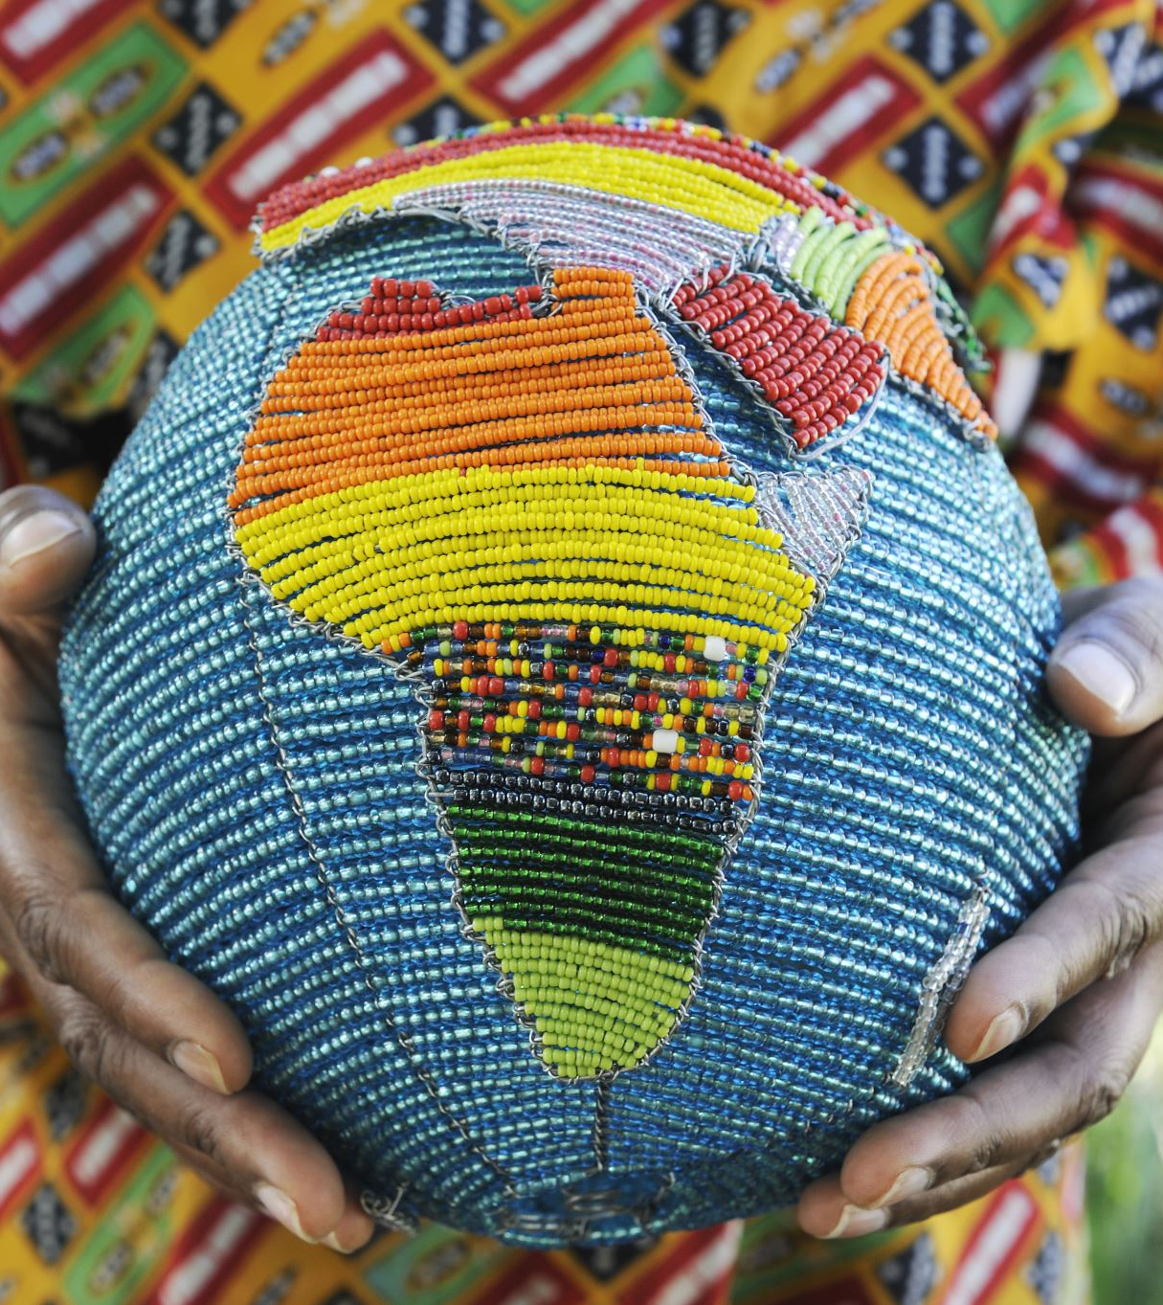



2013 Wealth Divide
In 2013, Malawi, a landlocked country in southeastern Africa, had a population of 16,190,126 and a GDP per capita (current US$) of $239.87
Based on findings, it was ranked the poorest country that year.
On the opposite end of the spectrum in 2013 stands Luxembourg, a small European country, surrounded by Belgium, France and Germany. The wealthiest country ranked that year, it had a population of 543,360 and a GDP per capita (current US$) of $113,726.64

Slide 5
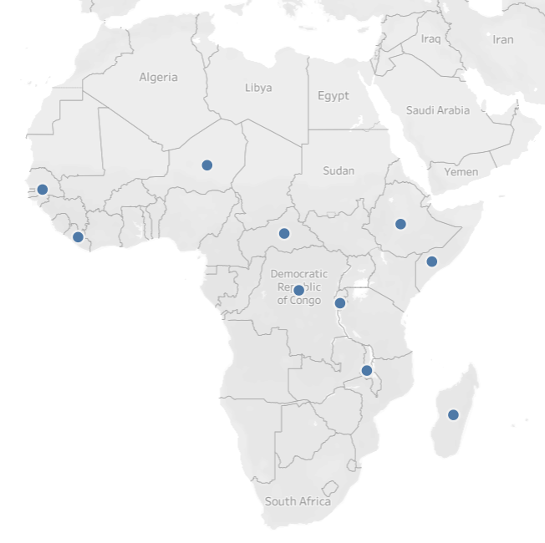
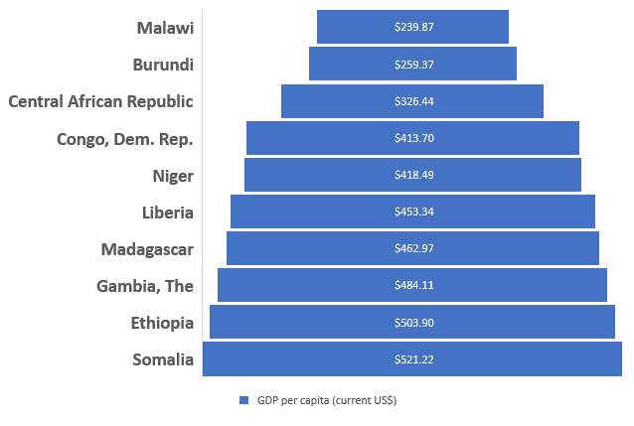
2013 Poorest Countries in the World*
* According to GDP per capita (current US$)

Slide 6
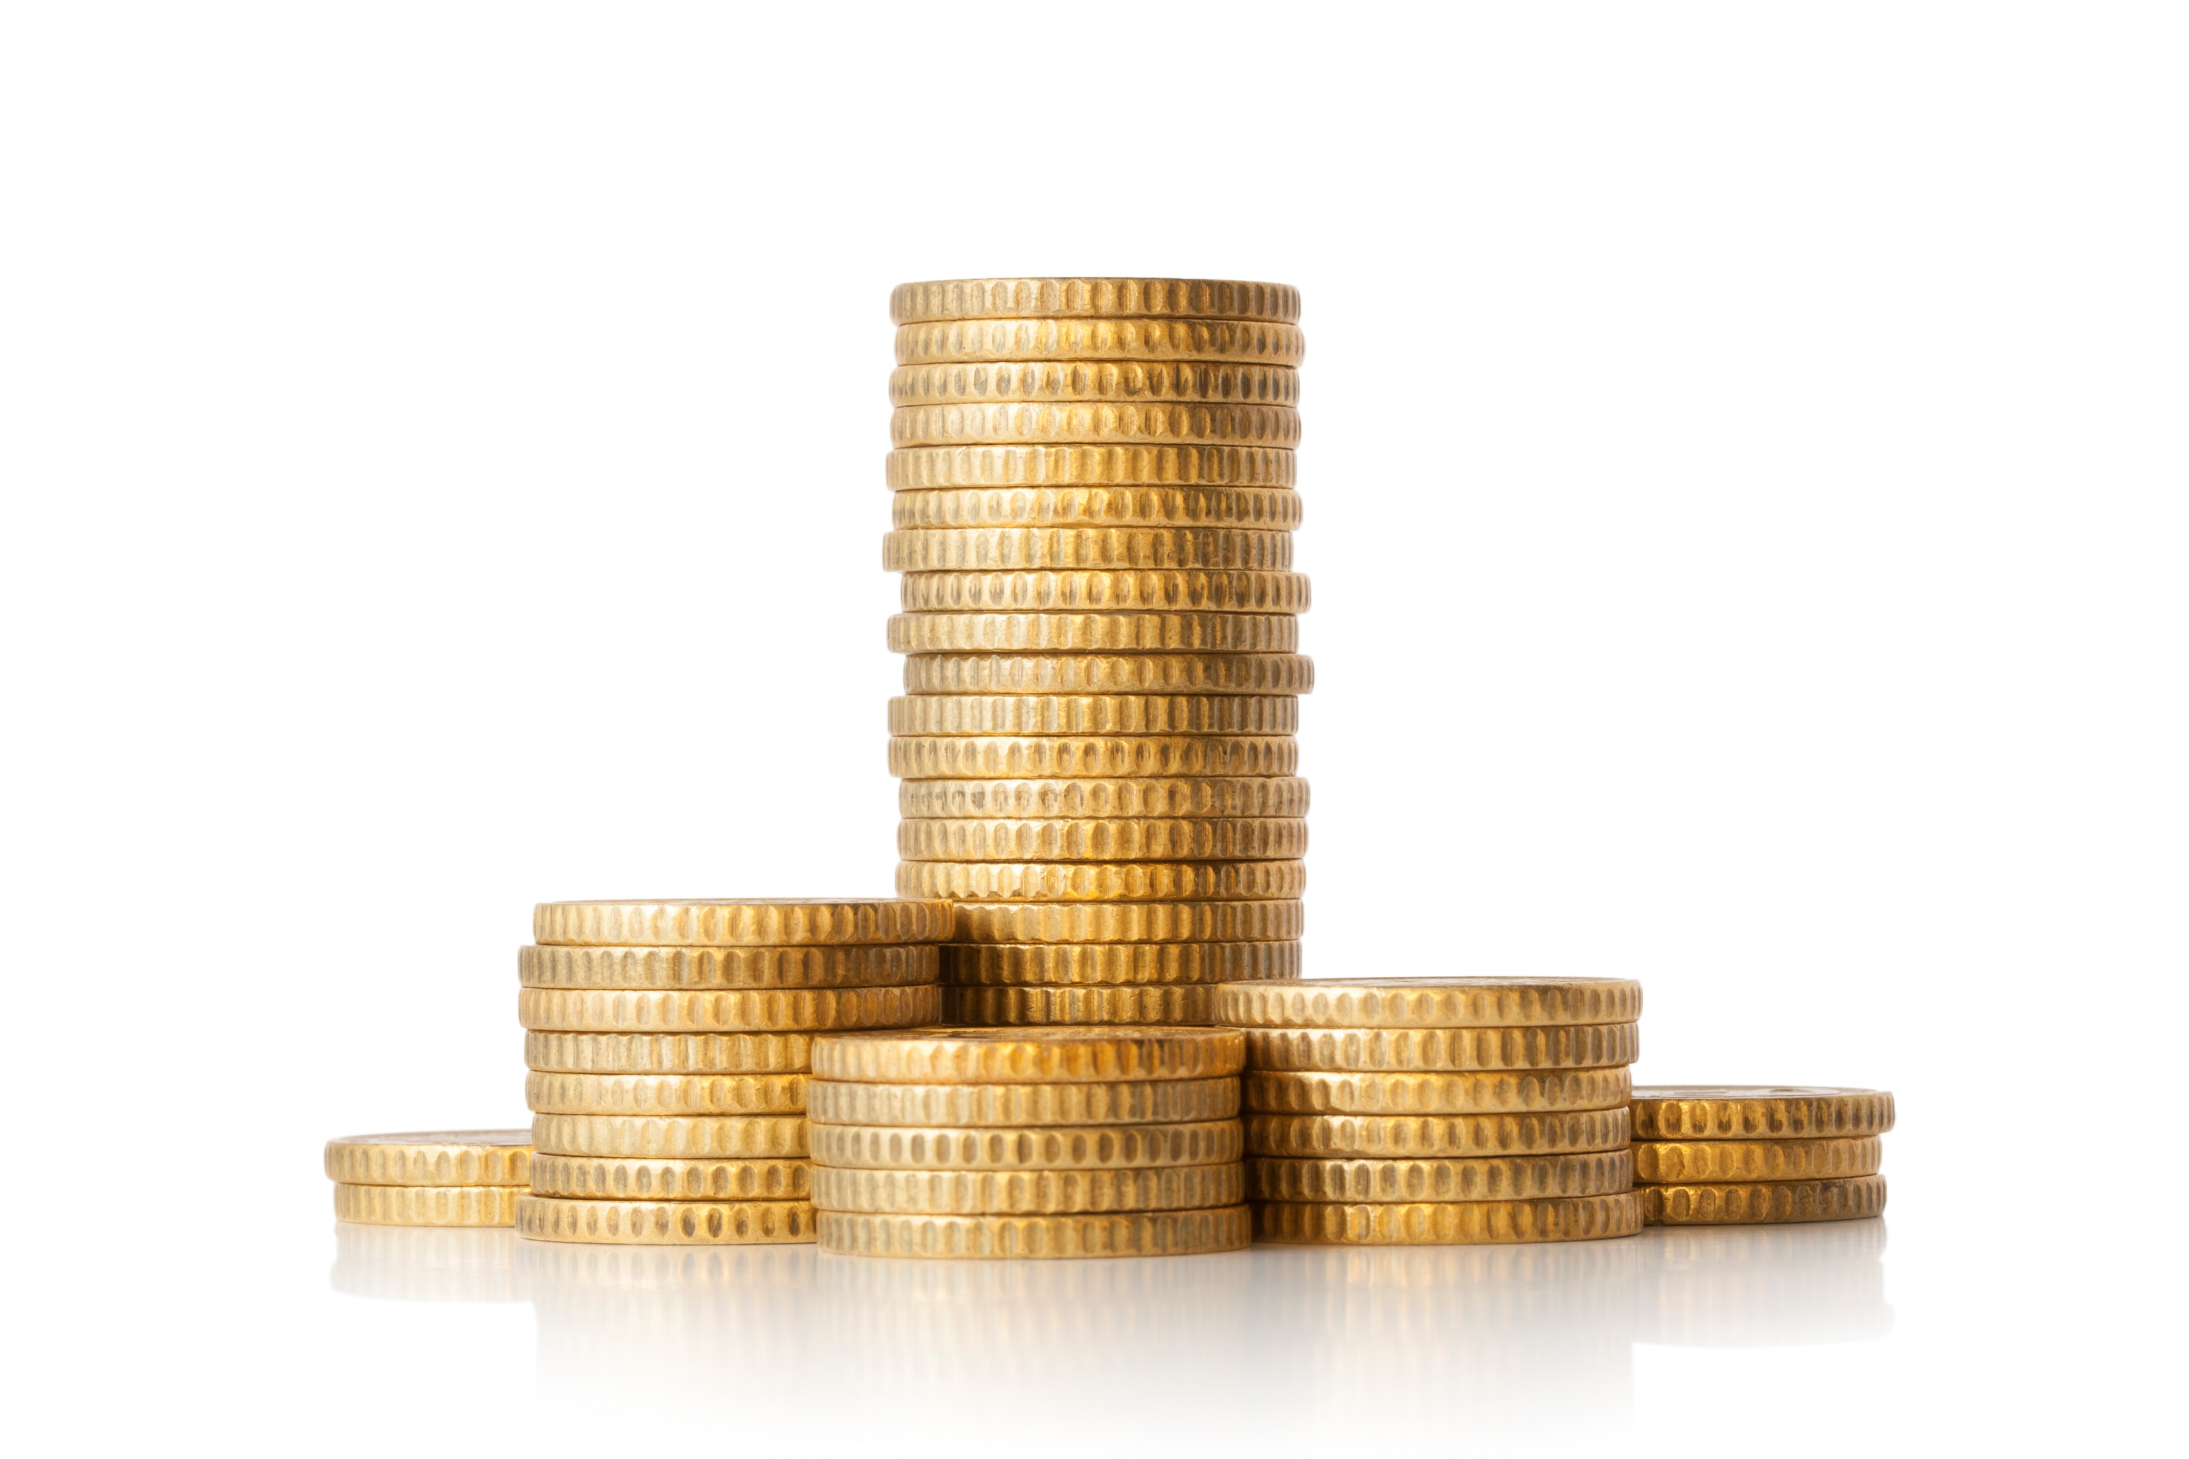
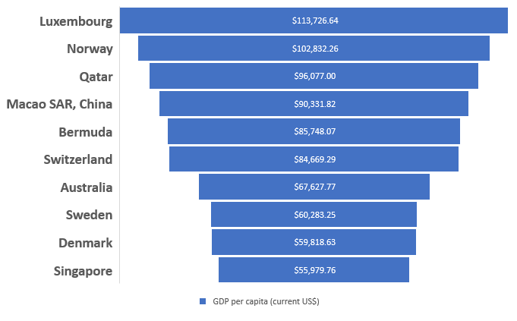
2013 Richest Countries in the World*
* According to GDP per capita (current US$)

Slide 7
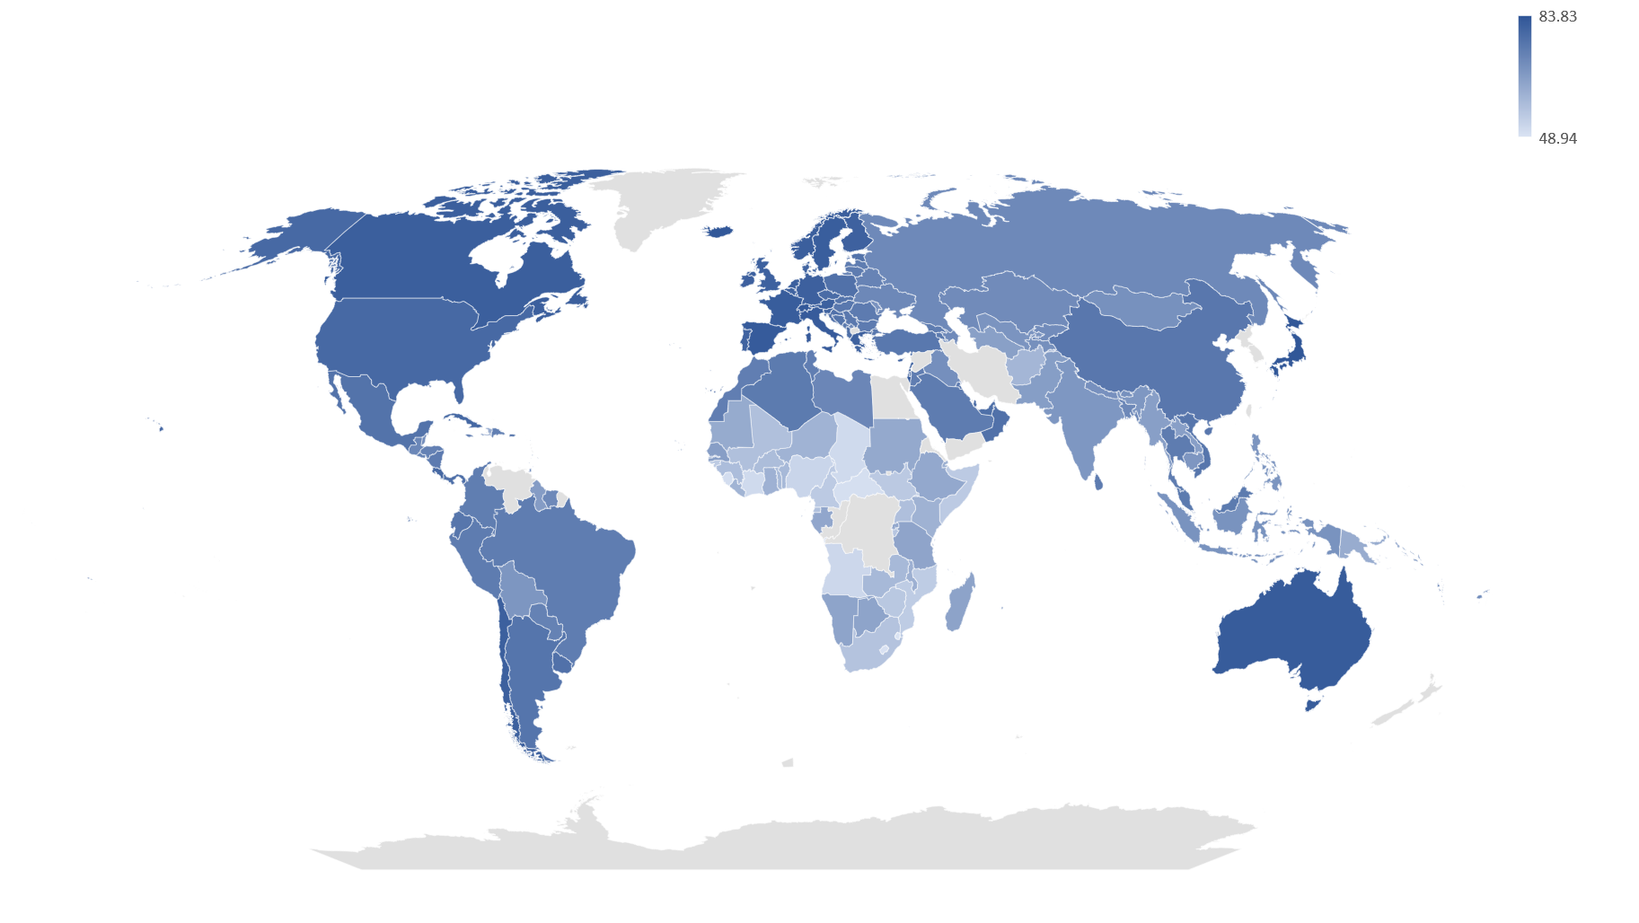
Life Expectancy Around the World
Highest Global Life Expectancy:
84 years - Hong Kong SAR, China
Lowest Global Life Expectancy: 49 years - Swaziland

Slide 8

Life Expectancy of the Poorest & Richest Nations
2013 WEALTHIEST COUNTRIES
Country | Life Expectancy
Qatar | 78.4
Denmark | 80.3
Macao SAR, China | 80.3
Bermuda | 80.6
Norway | 81.5
Sweden | 81.7
Luxembourg | 81.8
Australia | 82.2
Singapore | 82.3
Switzerland | 82.7
GLOBAL AVG.
2013 POOREST COUNTRIES
Country | Life Expectancy
Central African Republic | 49.9
Somalia | 55.0
Burundi | 56.3
Congo, Dem. Rep. | 58.3
Gambia, The | 60.0
Liberia | 60.5
Niger | 60.8
Malawi | 61.5
Ethiopia | 63.4
Madagascar | 64.7
71.5yrs

Slide 9


Is GDP per capita an accurate indicator of life expectancy?
Does Wealth Always Equal Health?
Or in this case, longevity…

Slide 10
2013 Global Life Expectancy vs. GDP per capita
Overarching Question:
Does Wealth Always Equal Health? Or in this case, longevity…

Slide 11
Key Findings & Takeaways
Countries with a higher GDP per capita have a higher life expectancy
However..
A good majority of lower GDP per capita countries outside of the African continent have a close to or above average life expectancy
I need to retire real soon!!
Also..

Slide 12

Questions?

Slide 13



Thank you!

